Slide 1
Module 10
Regression Inference

Slide 2
Announcements

Slide 3
Regression Model

Slide 4
A “Model”: Signal + Noise
Distance drawn at random from normal distribution with mean 0
Another distance drawn independently from the same normal distribution

Slide 5
What We Get to See
(Demo)

Slide 6
Prediction Variability

Slide 7
Regression Prediction
If the data come from the regression model,
The regression line is close to true line
Given a new value of x, predict y by finding the point on the regression line at that x

Slide 8
Confidence Interval for Prediction
Bootstrap the scatter plot
Get a prediction for y using the regression line that goes through the resampled plot
Repeat the two steps above many times
Draw the empirical histogram of all the predictions.
Get the “middle 95%” interval.
That’s an approximate 95% confidence interval for the predicted value of y.
(Demo)

Slide 9
Predictions at Different Values of x
Since y is correlated with x, the predicted values of y depend on the value of x.
The width of the prediction interval also depends on x.
Typically, intervals are wider for values of x that are further away from the mean of x.

Slide 10
The True Slope

Slide 11
Confidence Interval for True Slope
Bootstrap the scatter plot.
Find the slope of the regression line through the bootstrapped plot.
Repeat.
Draw the empirical histogram of all the generated slopes.
Get the “middle 95%” interval.
That’s an approximate 95% confidence interval for the slope of the true line.
(Demo)

Slide 12



Rain on the Regression Parade
We observed a slope based on our sample of points.
But what if the sample scatter plot got its slope just by chance?
What if the true line is actually FLAT?
(Demo)

Slide 13
Test Whether There Really is a Slope
Null hypothesis: The slope of the true line is 0.
Alternative hypothesis: No, it’s not.
Method:
Construct a bootstrap confidence interval for the true slope.
If the interval doesn’t contain 0, reject the null hypothesis.
If the interval does contain 0, there isn’t enough evidence to reject the null hypothesis.

Slide 14
Module 10
Classification

Slide 15
Announcements

Slide 16
Classification

Slide 17

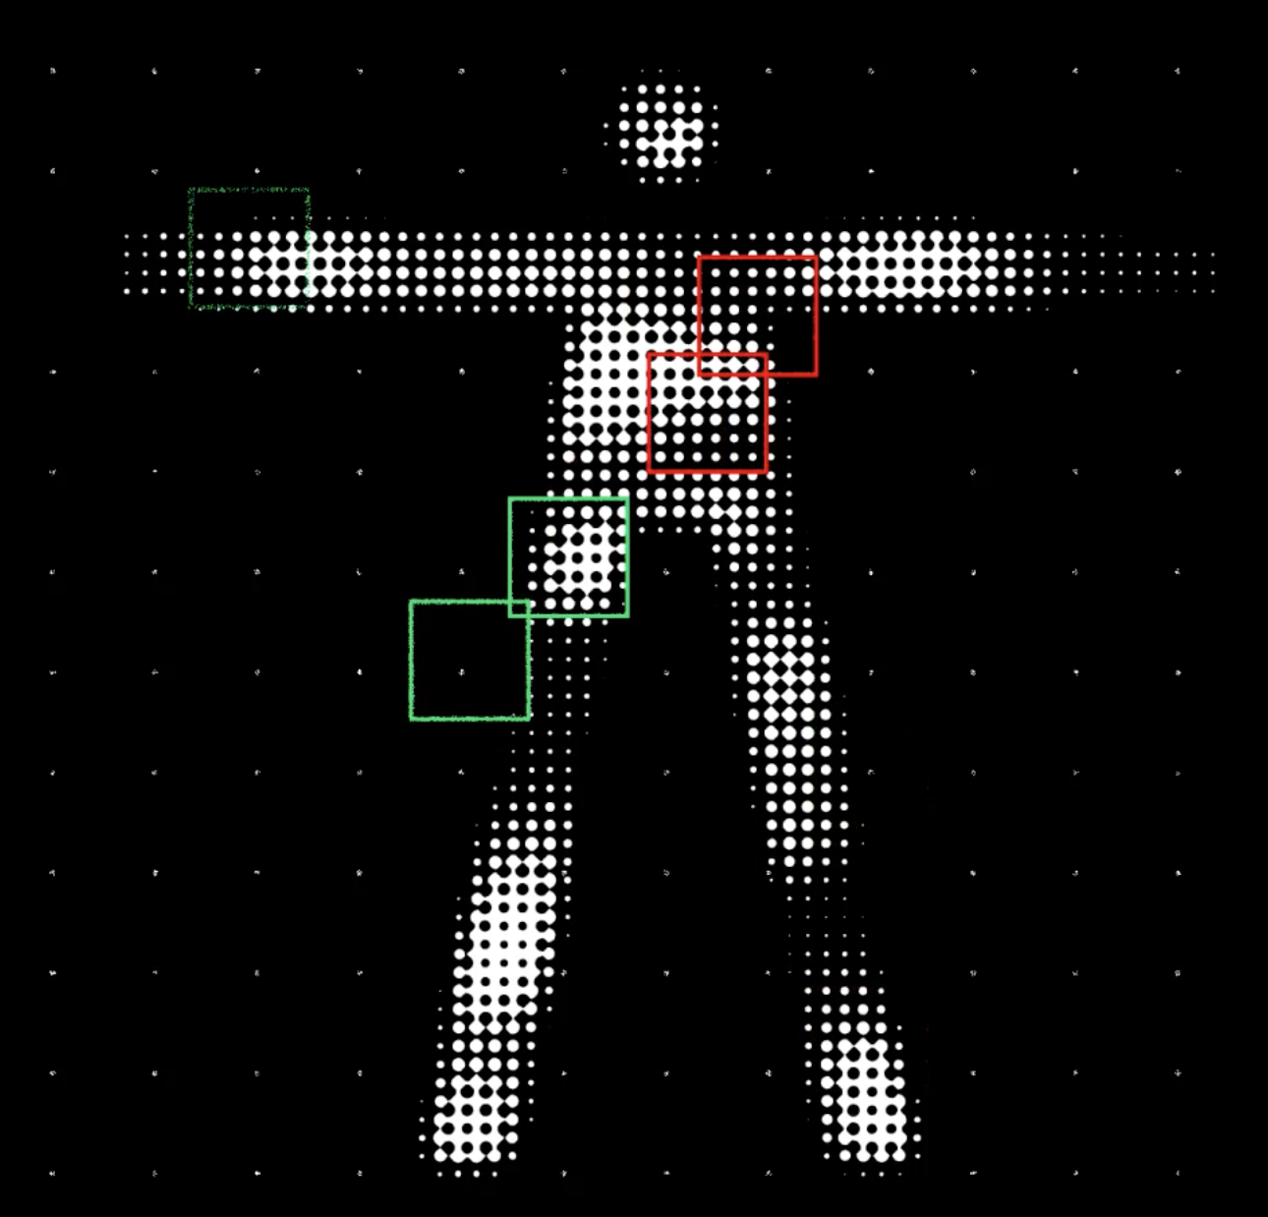
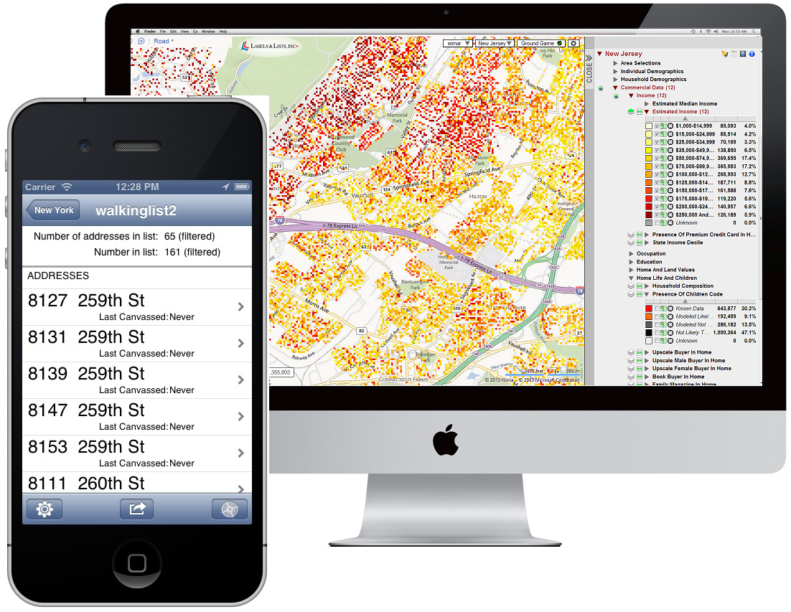

Classification Examples
(Demo)
Notes:
Fraud: order fraud (Amazon, PayPal, etc.), account fraud (LinkedIn)
Dating: https://www.wired.com/2014/01/how-to-hack-okcupid/
If, through statistical sampling, McKinlay could ascertain which questions mattered to the kind of women he liked, he could construct a new profile that honestly answered those questions and ignored the rest. He could match every woman in LA who might be right for him, and none that weren’t.
Diagnosis: http://www.newyorker.com/magazine/2017/04/03/ai-versus-md
In June, 2015, Thrun’s team began to test what the machine had learned from the master set of images by presenting it with a “validation set”: some fourteen thousand images that had been diagnosed by dermatologists (although not necessarily by biopsy). Could the system correctly classify the images into three diagnostic categories—benign lesions, malignant lesions, and non-cancerous growths? The system got the answer right seventy-two per cent of the time. (The actual output of the algorithm is not “yes” or “no” but a probability that a given lesion belongs to a category of interest.) Two board-certified dermatologists who were tested alongside did worse: they got the answer correct sixty-six per cent of the time.
Personality: https://motherboard.vice.com/en_us/article/how-our-likes-helped-trump-win (Cambridge Analytica—Board member Steve Bannon)
Link personality tests to Facebook profiles
"Followers of Lady Gaga were most probably extroverts, while those who "liked" philosophy tended to be introverts. While each piece of such information is too weak to produce a reliable prediction, when tens, hundreds, or thousands of individual data points are combined, the resulting predictions become really accurate."
"Up to now, explains Nix, election campaigns have been organized based on demographic concepts. "A really ridiculous idea. The idea that all women should receive the same message because of their gender—or all African Americans because of their race." What Nix meant is that while other campaigners so far have relied on demographics, Cambridge Analytica was using psychometrics."
Machine learning to predict recidivism (for parole), to predict whether the bank shoud give you a loan, to predict whether immigrants should be admitted to US. Racism, fairness.

Slide 18
Classifiers

Slide 19
Training a Classifier
Classifier
Attributes of an example
Predicted label of the example
Model the association between attributes & labels
Population
Sample
Labels
Training
Set
Estimate the accuracy of the classifier
Test
Set

Slide 20
Module 10
Classifiers

Slide 21
Announcements

Slide 22
Classifiers

Slide 23
Training a Classifier
Classifier
Attributes of an example
Predicted label of the example
Model the association between attributes & labels
Population
Sample
Labels
Training
Set
Estimate the accuracy of the classifier
Test
Set

Slide 24
Nearest Neighbor Classifier
NN Classifier
Use the label of the most similar training example
Attributes of an example
Predicted label of the example
Population
Sample
Labels
Training
Set
Test
Set

Slide 25
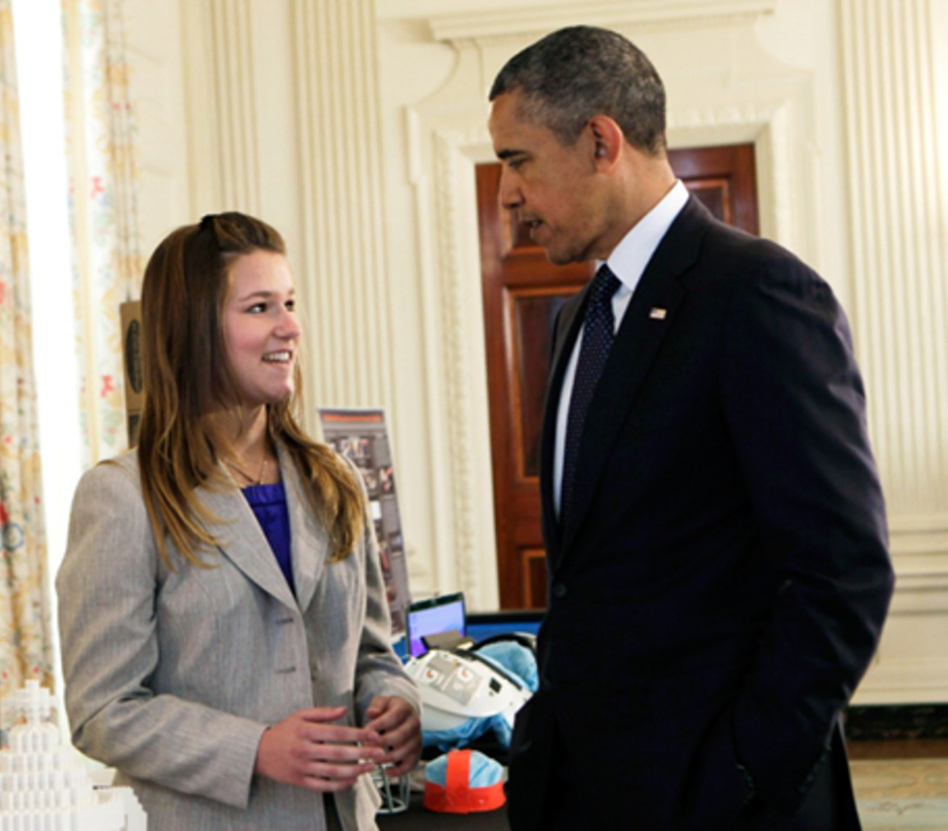
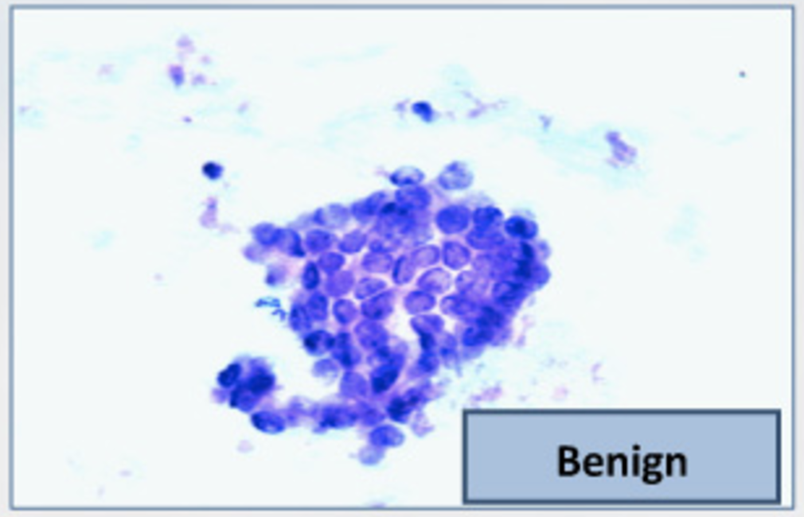
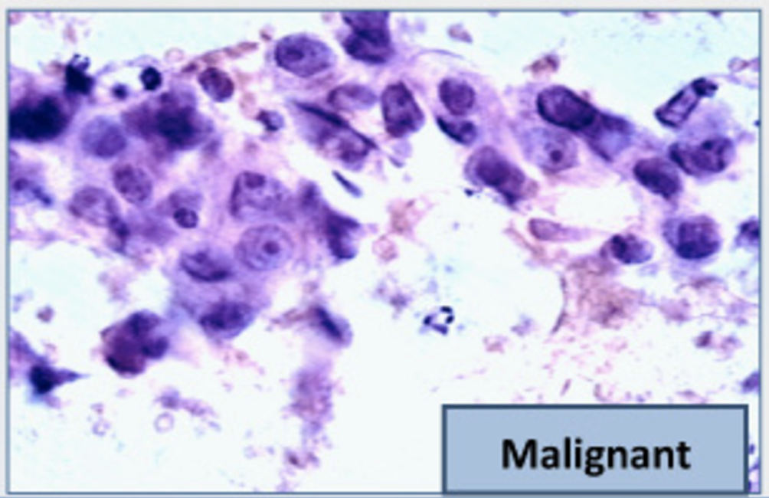
The Google Science Fair
Brittany Wenger, a 17-year-old high school student in 2012
Won by building a breast cancer classifier with 99% accuracy
(Demo)

Slide 26
Distance

Slide 27
Rows of Tables
Each row contains all the data for one individual
t.row(i) evaluates to ith row of table t
t.row(i).item(j)is the value of column j in row i
If all values are numbers, then np.array(t.row(i)) evaluates to an array of all the numbers in the row.
To consider each row individually, use for row in t.rows: ... row.item(j) ...

Slide 28
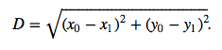
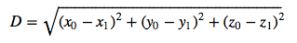
Distance Between Two Points
Two attributes x and y:
Three attributes x, y, and z:
(Demo)
and so on ...

Slide 29
Nearest Neighbors

Slide 30
Finding the k Nearest Neighbors
To find the k nearest neighbors of an example:
Find the distance between the example and each example in the training set
Augment the training data table with a column containing all the distances
Sort the augmented table in increasing order of the distances
Take the top k rows of the sorted table
(Demo)

Slide 31
The Classifier
To classify a point:
Find its k nearest neighbors
Take a majority vote of the k nearest neighbors to see which of the two classes appears more often
Assign the point the class that wins the majority vote
(Demo)

Slide 32
Evaluation

Slide 33
Accuracy of a Classifier
The accuracy of a classifier on a labeled data set is the proportion of examples that are labeled correctly
Need to compare classifier predictions to true labels
If the labeled data set is sampled at random from a population, then we can infer accuracy on that population
Sample
Labels
Training
Set
Test
Set
(Demo)

Slide 34
Decision Boundaries
A change in input attributes might change the prediction
Inputs that are very close but result in different predicted labels are on either side of a decision boundary
To visualize, plot predictions of a regular set of inputs
(Demo)

Slide 35
Module 10
Decisions

Slide 36
Announcements

Slide 37
Decisions

Slide 38
The Medical Diagnosis Problem
Suppose there is a rare disease with a prevalence of 1/1000.
Suppose that there is an imperfect test that indicates that you have the disease 99% of the time when you really do, and 5% of the time when you really don’t.
Q1: What is the probability that a randomly selected person in the population has the disease?
A1: P(D) = 0.001. This is called the prior probability of disease.

Slide 39
The Medical Diagnosis Problem
Suppose there is a rare disease with a prevalence of 1/1000.
Suppose that there is an imperfect test that indicates that you have the disease 99% of the time when you really do, and 5% of the time when you really don’t.
Q2: What is the probability that a randomly selected person tests positive if they do have the disease?
A2: P(TP|D) = 0.99. This is the likelihood of testing positive given that you have the disease.

Slide 40
The Medical Diagnosis Problem
Suppose there is a rare disease with a prevalence of 1/1000.
Suppose that there is an imperfect test that indicates that you have the disease 99% of the time when you really do, and 5% of the time when you really don’t.
Q3: What is the probability that a randomly selected person tests positive if they do not have the disease (are healthy)?
A3: P(TP|H)=0.05. This is the false positive rate of the test. It is the likelihood of testing positive given that you do not have the disease.

Slide 41
The Medical Diagnosis Problem
Suppose there is a rare disease with a prevalence of 1/1000.
Suppose that there is an imperfect test that indicates that you have the disease 99% of the time when you really do, and 5% of the time when you really don’t.
Q4: What is the probability that a randomly selected person is healthy and tests positive?

Slide 42
Conditional Probability Tree
Suppose there is a rare disease with a prevalence of 1/1000.
Suppose that there is an imperfect test that indicates that you have the disease 99% of the time when you really do, and 5% of the time when you really don’t.
P(TP|D)
TP
D
P(D)
TN
P(TN|D)
P(TP|H)
TP
P(H)
H
TN
P(TN|H)

Slide 43
Conditional Probability Tree
Suppose there is a rare disease with a prevalence of 1/1000.
Suppose that there is an imperfect test that indicates that you have the disease 99% of the time when you really do, and 5% of the time when you really don’t.
P(TP|D)
TP
0.99
D
0.001
P(D)
TN
0.01
P(TN|D)
P(TP|H)
TP
0.05
0.999
H
P(H)
TN
0.95
P(TN|H)

Slide 44
Back to Questions…
Q4: What is the probability that a randomly selected person is healthy and tests positive?
A4: P(H,TP)=P(H)P(TP|H) = 0.999x0.05
This is the joint probability of being healthy and testing positive.
0.99
TP
D
0.001
TN
0.01
0.05
TP
0.999
H
TN
0.95

Slide 45
More Questions…
Q5: What is the probability that a randomly selected person tests positive?
A5: P(TP)=P(H)P(TP|H) +P(D)P(TP|D)
0.99
TP
D
0.001
TN
0.01
= 0.999x0.05 +0.001x0.99
0.05
TP
0.999
H
= 0.05095
TN
0.95
This is the marginal probability of testing positive.

Slide 46
More Questions…
Q6: What is the probability that a randomly selected person has the disease if they test positive?
0.99
TP
D
0.001
TN
0.01
0.05
TP
0.999
H
TN
0.95

Slide 47
Some Intuition…
Out of 1000 people, on average:
0.99
TP
 | Test Pos. | Test Neg.
Disease
Healthy
D
0.001
TN
0.01
0.05
TP
0.999
H
TN
0.95

Slide 48
Some Intuition…
Out of 1000 people, on average:
0.99
TP
 | Test Pos. | Test Neg.
Disease | ~1
Healthy
D
0.001
TN
0.01
0.05
TP
0.999
H
TN
0.95

Slide 49
Some Intuition…
Out of 1000 people, on average:
0.99
TP
 | Test Pos. | Test Neg.
Disease | ~1 | ~0
Healthy
D
0.001
TN
0.01
0.05
TP
0.999
H
TN
0.95

Slide 50
Some Intuition…
Out of 1000 people, on average:
0.99
TP
 | Test Pos. | Test Neg.
Disease | ~1 | ~0
Healthy | ~50
D
0.001
TN
0.01
0.05
TP
0.999
H
TN
0.95

Slide 51
Some Intuition…
Out of 1000 people, on average:
0.99
TP
 | Test Pos. | Test Neg.
Disease | ~1 | ~0
Healthy | ~50 | ~950
D
0.001
TN
0.01
So only ~1/50 or 2% of patients with positive test results have the disease.
0.05
TP
0.999
H
TN
0.95

Slide 52
The Math…
P(D|TP) = P(D,TP)/P(TP)
P(D,TP) = P(TP|D)P(D) = 0.99x0.001 = 0.00099
P(TP) = P(D, TP) + P(H, TP)
P(H,TP) = P(TP|H)P(H) = 0.05x0.999 = 0.04995
P(D|TP) = 0.00099/0.0594 = 0.0194
0.99
TP
D
0.001
TN
0.01
0.05
TP
0.999
H
TN
0.95

Slide 53
Bayes’ Rule
P(TP,D)
P(D|TP) =
P(TP)

Slide 54
Bayes’ Rule
Posterior
Likelihood
Prior
P(TP|D)P(D)
P(TP,D)
P(D|TP) =
P(TP|D)P(D) + P(TP|H)P(H)
P(TP)

Slide 55
The Medical Diagnosis Problem
"We asked 20 house officers, 20 fourth-year medical students and 20 attending physicians, selected in 67 consecutive hallway encounters at four Harvard Medical School teaching hospitals, the following question:
"If a test to detect a disease whose prevalence is 1/1000 has a false positive rate of 5%, what is the chance that a person found to have a positive result actually has the disease, assuming that you know nothing about the person's symptoms or signs?"
Casscells et al. Interpretation by Physicians of Clinical Laboratory Results. NEJM, 1978.

Slide 56
The Medical Diagnosis Problem
"Eleven of 60 participants, or 18%, gave the correct answer. These participants included four of 20 fourth-year students, three of 20 residents in internal medicine and four of 20 attending physicians. The most common answer, given by 27, was that [the chance that a person found to have a positive result actually has the disease] was 95%.
Casscells et al. Interpretation by Physicians of Clinical Laboratory Results. NEJM, 1978.

Slide 57
Treatment Costs
Suppose a patient tests positive.
There is an effective medication to treat the patient, but it costs $1000.
If the patient has the disease and is not treated now, on average it will cost $5000 to treat them after the disease progresses.
Q6: Should we treat now?
Y
$1000
D
M
0.0194
N
$5000
Y
$1000
0.9806
H
M
N
$0

Slide 58
Treatment Costs
What is the expected cost of treatment?
E[C|M=Y] = P(D)x1000 + P(H)x1000
Y
$1000
D
M
0.0194
N
$5000
= $1000
Y
$1000
0.9806
H
M
N
$0

Slide 59
Treatment Costs
What is the expected cost of not treating the patient?
E[C|M=N] = P(D)x5000 + P(H)x0
Y
$1000
D
M
0.0194
N
$5000
= $97
Y
$1000
0.9806
H
M
N
$0

Slide 60
Treatment Costs
Q6: Should we treat now?
A6: According to expected treatment cost, it costs less on average to not treat a patient with a positive test now. We should wait and treat the patient later if it turns out the really do have the disease.
Y
$1000
D
M
0.0194
N
$5000
Y
$1000
0.9806
H
M
N
$0

Slide 61
Effect of Medication Costs
Q7: How about now?
E[C|M=Y] = P(D)x50 + P(H)x50
Y
$50
D
M
0.0194
N
$5000
= $50
E[C|M=N] = P(D)x5000 + P(H)x0
Y
$50
0.9806
H
= $97
M
The expected costs support immediate treatment.
N
$0

Slide 62
Module 10
Case Study: Health

Slide 63
Announcements

Slide 64
Introduction
(Excerpt 2:45)

Slide 65
Malcolm Gladwell
Author (Blink, The Tipping Point) & journalist (New Yorker)
"Revisionist History will go back and reinterpret something from the past: an event, a person, an idea. Something overlooked. Something misunderstood."
You should listen to the whole episode: Season 2, Episode 10
http://revisionisthistory.com/episodes/20-the-basement-tapes

Slide 66
The Diet-Heart Hypothesis

Slide 67
Cardiovascular Disease
Atherosclerosis narrows arteries due to plaque buildup.
#1 cause of death and disability in the developed world.
Cardiovascular disease (CVD) is the leading global cause of death: 17.3 million deaths per year.
The causes are not known, but there are associations with high blood pressure, diabetes, smoking, obesity, family history, age, inactivity, and an unhealthy diet.
https://www.nhlbi.nih.gov/health/health-topics/topics/atherosclerosis/atrisk

Slide 68
Diet & Cardiovascular Disease
1.7M deaths worldwide are attributed to low fruit and vegetable consumption by the WHO (2011).
High intake of salt is linked to high blood pressure.
High intake of processed foods is linked to obesity.
Eliminating trans fats is widely recommended.
Added sugar is linked to high blood pressure & obesity.
High intake of alcohol is associated with CVD risk.
http://www.who.int/cardiovascular_diseases/publications/atlas_cvd/en/

Slide 69
The Diet-Heart Hypothesis
Hypothesis:
Replacing saturated fat (e.g. dairy) with polyunsaturated fat (e.g. plant-based oil) reduces risk of heart disease.
Justification:
This replacement reduces serum cholesterol.
Serum cholesterol is associated with heart disease.
"Clinical trials that used polyunsaturated fat to replace saturated fat reduced the incidence of CVD." (AHA, 2017)
http://circ.ahajournals.org/content/early/2017/06/15/CIR.0000000000000510

Slide 70
Hypothesis Testing

Slide 71
Designing an Experiment
Hypothesis:
Replacing saturated fat (e.g. dairy) with polyunsaturated fat (e.g. plant-based oil) reduces risk of heart disease.
What evidence would support this hypothesis?

Slide 72
Minnesota Coronary Experiment (1968-1973)
(Excerpt 11:10)

Slide 73
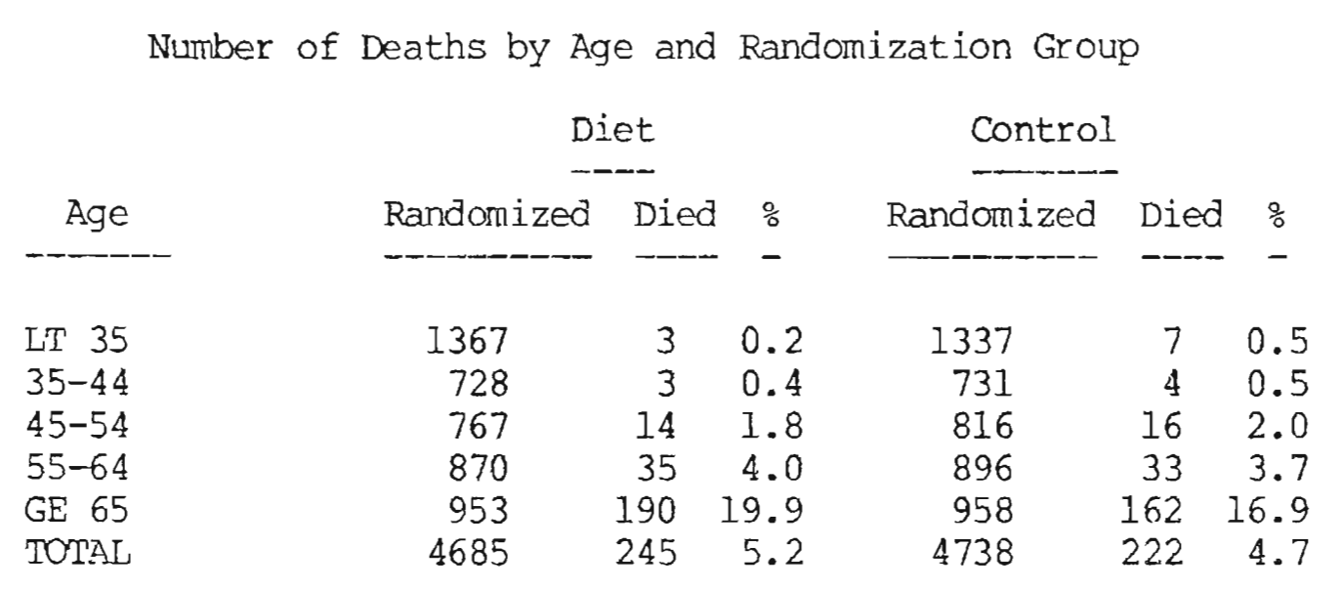
Broste Thesis Figure 6
(Demo)
(Excerpt 3:35)
http://www.psych.uic.edu/download/Broste_thesis_1981.pdf

Slide 74
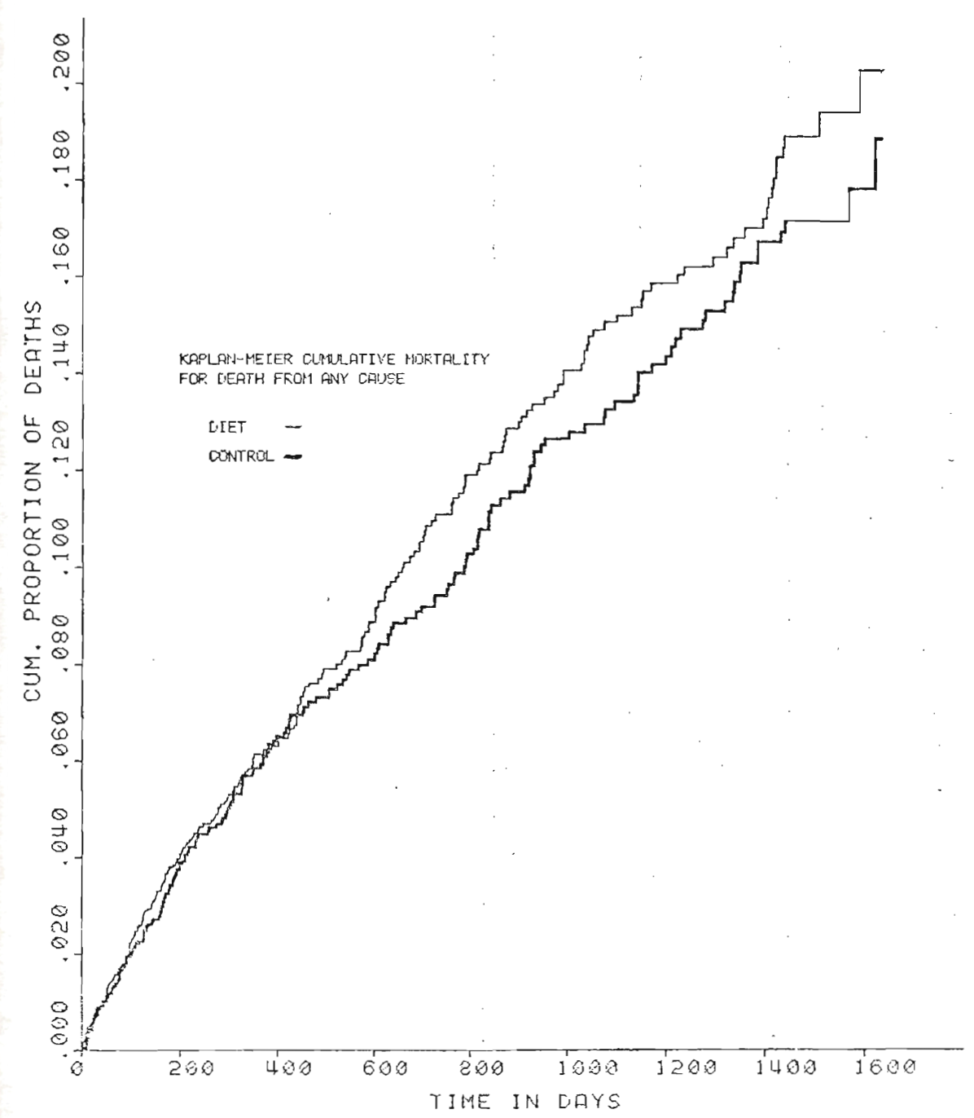
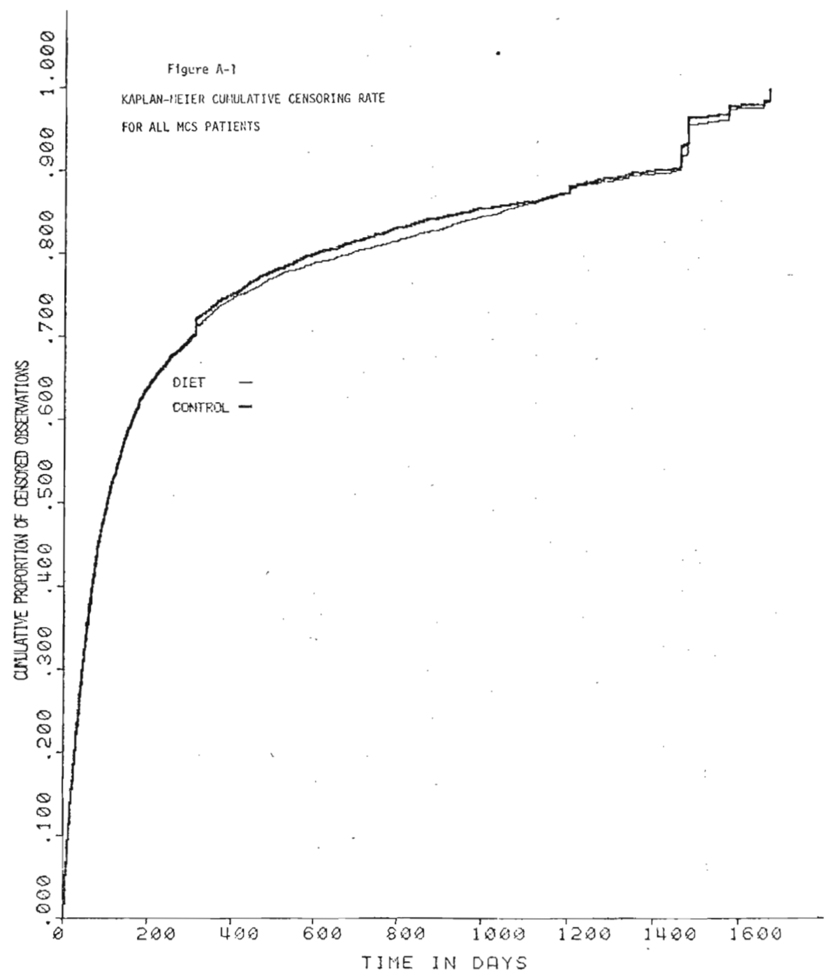
Broste Thesis Figures

Slide 75
Other Clinical Trials

Slide 76
Controlled Experiments
Wadsworth Hospital and Veterans Administration Center in Los Angeles evaluated a diet [using] corn, soybean, safflower, and cottonseed oils, all high in polyunsaturated linoleic acid, to replace saturated fat in the control diet (846 men; mean age of 65 years; 30% had CVD; 8 year duration).
Oslo Diet-Heart Study evaluated changing to a low saturated, high polyunsaturated fat diet (412 men with prior MI).
British Medical Research Council compared a diet containing soybean oil, 86 g/d, with a diet with saturated fat from animal products (393 men with prior MI).
http://circ.ahajournals.org/content/early/2017/06/15/CIR.0000000000000510

Slide 77
Finnish Mental Hospital Study
"The Finnish Mental Hospital Study compared a diet high in polyunsaturated fat, mainly from soybean oil, with a diet high in saturated fat in 1222 patients at 2 psychiatric hospitals. In 1 hospital, the high polyunsaturated fat diet was given first, followed by the saturated fat diet; in the other hospital, the diets were given in the reverse order (1222 patients; 6 years)."
Non-blind & conditions evaluated at different times.
"The amount of sugar in the diet varied by almost 50%."
"The use of psychiatric drugs with known cardiovascular side effects differed substantially between groups."
http://circ.ahajournals.org/content/early/2017/06/15/CIR.0000000000000510 http://wholehealthsource.blogspot.com/2009/07/finnish-mental-hospital-trial.html

Slide 78
Module 10
Decisions

Slide 79
Announcements

Slide 80
Decisions

Slide 81
The Medical Diagnosis Problem
Suppose there is a rare disease with a prevalence of 1/1000.
Suppose that there is an imperfect test that indicates that you have the disease 99% of the time when you really do, and 5% of the time when you really don’t.
Q1: What is the probability that a randomly selected person in the population has the disease?
A1: P(D) = 0.001. This is called the prior probability of disease.

Slide 82
The Medical Diagnosis Problem
Suppose there is a rare disease with a prevalence of 1/1000.
Suppose that there is an imperfect test that indicates that you have the disease 99% of the time when you really do, and 5% of the time when you really don’t.
Q2: What is the probability that a randomly selected person tests positive if they do have the disease?
A2: P(TP|D) = 0.99. This is the likelihood of testing positive given that you have the disease.

Slide 83
The Medical Diagnosis Problem
Suppose there is a rare disease with a prevalence of 1/1000.
Suppose that there is an imperfect test that indicates that you have the disease 99% of the time when you really do, and 5% of the time when you really don’t.
Q3: What is the probability that a randomly selected person tests positive if they do not have the disease (are healthy)?
A3: P(TP|H)=0.05. This is the false positive rate of the test. It is the likelihood of testing positive given that you do not have the disease.

Slide 84
The Medical Diagnosis Problem
Suppose there is a rare disease with a prevalence of 1/1000.
Suppose that there is an imperfect test that indicates that you have the disease 99% of the time when you really do, and 5% of the time when you really don’t.
Q4: What is the probability that a randomly selected person is healthy and tests positive?

Slide 85
Conditional Probability Tree
Suppose there is a rare disease with a prevalence of 1/1000.
Suppose that there is an imperfect test that indicates that you have the disease 99% of the time when you really do, and 5% of the time when you really don’t.
P(TP|D)
TP
D
P(D)
TN
P(TN|D)
P(TP|H)
TP
P(H)
H
TN
P(TN|H)

Slide 86
Conditional Probability Tree
Suppose there is a rare disease with a prevalence of 1/1000.
Suppose that there is an imperfect test that indicates that you have the disease 99% of the time when you really do, and 5% of the time when you really don’t.
P(TP|D)
TP
0.99
D
0.001
P(D)
TN
0.01
P(TN|D)
P(TP|H)
TP
0.05
0.999
H
P(H)
TN
0.95
P(TN|H)

Slide 87
Back to Questions…
Q4: What is the probability that a randomly selected person is healthy and tests positive?
A4: P(H,TP)=P(H)P(TP|H) = 0.999x0.05
This is the joint probability of being healthy and testing positive.
0.99
TP
D
0.001
TN
0.01
0.05
TP
0.999
H
TN
0.95

Slide 88
More Questions…
Q5: What is the probability that a randomly selected person tests positive?
A5: P(TP)=P(H)P(TP|H) +P(D)P(TP|D)
0.99
TP
D
0.001
TN
0.01
= 0.999x0.05 +0.001x0.99
0.05
TP
0.999
H
= 0.05095
TN
0.95
This is the marginal probability of testing positive.

Slide 89
More Questions…
Q6: What is the probability that a randomly selected person has the disease if they test positive?
0.99
TP
D
0.001
TN
0.01
0.05
TP
0.999
H
TN
0.95

Slide 90
Some Intuition…
Out of 1000 people, on average:
0.99
TP
 | Test Pos. | Test Neg.
Disease
Healthy
D
0.001
TN
0.01
0.05
TP
0.999
H
TN
0.95

Slide 91
Some Intuition…
Out of 1000 people, on average:
0.99
TP
 | Test Pos. | Test Neg.
Disease | ~1
Healthy
D
0.001
TN
0.01
0.05
TP
0.999
H
TN
0.95

Slide 92
Some Intuition…
Out of 1000 people, on average:
0.99
TP
 | Test Pos. | Test Neg.
Disease | ~1 | ~0
Healthy
D
0.001
TN
0.01
0.05
TP
0.999
H
TN
0.95

Slide 93
Some Intuition…
Out of 1000 people, on average:
0.99
TP
 | Test Pos. | Test Neg.
Disease | ~1 | ~0
Healthy | ~50
D
0.001
TN
0.01
0.05
TP
0.999
H
TN
0.95

Slide 94
Some Intuition…
Out of 1000 people, on average:
0.99
TP
 | Test Pos. | Test Neg.
Disease | ~1 | ~0
Healthy | ~50 | ~950
D
0.001
TN
0.01
So only ~1/50 or 2% of patients with positive test results have the disease.
0.05
TP
0.999
H
TN
0.95

Slide 95
The Math…
P(D|TP) = P(D,TP)/P(TP)
P(D,TP) = P(TP|D)P(D) = 0.99x0.001 = 0.00099
P(TP) = P(D, TP) + P(H, TP)
P(H,TP) = P(TP|H)P(H) = 0.05x0.999 = 0.04995
P(D|TP) = 0.00099/0.0594 = 0.0194
0.99
TP
D
0.001
TN
0.01
0.05
TP
0.999
H
TN
0.95

Slide 96
Bayes’ Rule
P(TP,D)
P(D|TP) =
P(TP)

Slide 97
Bayes’ Rule
Posterior
Likelihood
Prior
P(TP|D)P(D)
P(TP,D)
P(D|TP) =
P(TP|D)P(D) + P(TP|H)P(H)
P(TP)

Slide 98
The Medical Diagnosis Problem
"We asked 20 house officers, 20 fourth-year medical students and 20 attending physicians, selected in 67 consecutive hallway encounters at four Harvard Medical School teaching hospitals, the following question:
"If a test to detect a disease whose prevalence is 1/1000 has a false positive rate of 5%, what is the chance that a person found to have a positive result actually has the disease, assuming that you know nothing about the person's symptoms or signs?"
Casscells et al. Interpretation by Physicians of Clinical Laboratory Results. NEJM, 1978.

Slide 99
The Medical Diagnosis Problem
"Eleven of 60 participants, or 18%, gave the correct answer. These participants included four of 20 fourth-year students, three of 20 residents in internal medicine and four of 20 attending physicians. The most common answer, given by 27, was that [the chance that a person found to have a positive result actually has the disease] was 95%.
Casscells et al. Interpretation by Physicians of Clinical Laboratory Results. NEJM, 1978.

Slide 100
Treatment Costs
Suppose a patient tests positive.
There is an effective medication to treat the patient, but it costs $1000.
If the patient has the disease and is not treated now, on average it will cost $5000 to treat them after the disease progresses.
Q6: Should we treat now?
Y
$1000
D
M
0.0194
N
$5000
Y
$1000
0.9806
H
M
N
$0

Slide 101
Treatment Costs
What is the expected cost of treatment?
E[C|M=Y] = P(D)x1000 + P(H)x1000
Y
$1000
D
M
0.0194
N
$5000
= $1000
Y
$1000
0.9806
H
M
N
$0

Slide 102
Treatment Costs
What is the expected cost of not treating the patient?
E[C|M=N] = P(D)x5000 + P(H)x0
Y
$1000
D
M
0.0194
N
$5000
= $97
Y
$1000
0.9806
H
M
N
$0

Slide 103
Treatment Costs
Q6: Should we treat now?
A6: According to expected treatment cost, it costs less on average to not treat a patient with a positive test now. We should wait and treat the patient later if it turns out the really do have the disease.
Y
$1000
D
M
0.0194
N
$5000
Y
$1000
0.9806
H
M
N
$0

Slide 104
Effect of Medication Costs
Q7: How about now?
E[C|M=Y] = P(D)x50 + P(H)x50
Y
$50
D
M
0.0194
N
$5000
= $50
E[C|M=N] = P(D)x5000 + P(H)x0
Y
$50
0.9806
H
= $97
M
The expected costs support immediate treatment.
N
$0

Slide 105
Module 10
Case Study: Education

Slide 106
Announcements

Slide 107
Tutoring in Computer Science

Slide 108
Small-Group Tutoring at Scale
Fall 2017 small-group mentoring/tutoring (CS Mentors & course tutors)
Course | CS 61A | Data 8 | CS 61B | CS 70 | EE 16A
Topic | Program structures | Foundations of data science | Data structures | Discrete math & probability | Linear algebra & circuits
Mentors | 84 | 31 | 51 | 25 | 9
Sections | 140 | 60 | 52 | 27 | 9
Students | 587 | 261 | 160 | 156 | 45

Slide 109
Mentoring Schedule in CS 61A
September 14, 2017 — CS 61A Midterm 1
September 15, 2017 — Sign-ups for adjunct sections open
September 17, 2017 — CS 61A Midterm 1 scores returned
September 18, 2017 — Weekly adjunct sections start
October 19, 2017 — CS 61A Midterm 2
(Demo)

Slide 110
What's Next?

Slide 111
Data Science

Slide 112
Why Data Science
Unprecedented access to data means that we can make new discoveries and more informed decisions.
Computation is a powerful ally in data processing, visualization, prediction, and statistical inference.
People can agree on evidence and measurement.

Slide 113
How to Analyze Data
Begin with a question from some domain, reasonable assumptions about the data, & a choice of methods.
Visualize, then quantify!
Perhaps the most important part: Interpretation of the results in the language of the domain, without statistical jargon.

Slide 114
How Not to Analyze Data
Begin with a question from some domain, reasonable assumptions about the data, & a choice of methods.
Visualize, then quantify!
Perhaps the most important part: Interpretation of the results in the language of the domain, without statistical jargon.

Slide 115
How to Analyze Data in 2018
Begin with a question from some domain, reasonable assumptions about the data, & a choice of methods.
Visualize, then quantify! (Both using computation.)
Perhaps the most important part: Interpretation of the results in the language of the domain, without statistical jargon.

